Slide 1
Automation
NUNIT
PYTEST
JENKINS

Slide 2
Python
Tools:
Python27
Pytest package
PyCharm Community Edition
Analyzer Result Test – Jenkins plugin

Slide 3
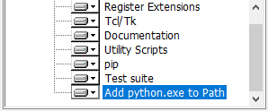
Python – Installation
Install python 2.7.15 (MSI x86-64) from: https://www.python.org/downloads/release/python-
2715/
During installation pay attention to the following:
Pip is part of the installation
Add python.exe to Path - Enabled
After the instllation done,
make sure that c:\python7, c:\python27\scripts, added to Path ( Environment variables).

Slide 4

Pytest Package installation
Open new cmd
In cmd: pip install pytest
In cmd: pip install pytest-html
Under c:\python27\scripts check the scripts added This is mean you will be able to run from anywhere (c:\python27\scripts is in the “Path”)

Slide 5
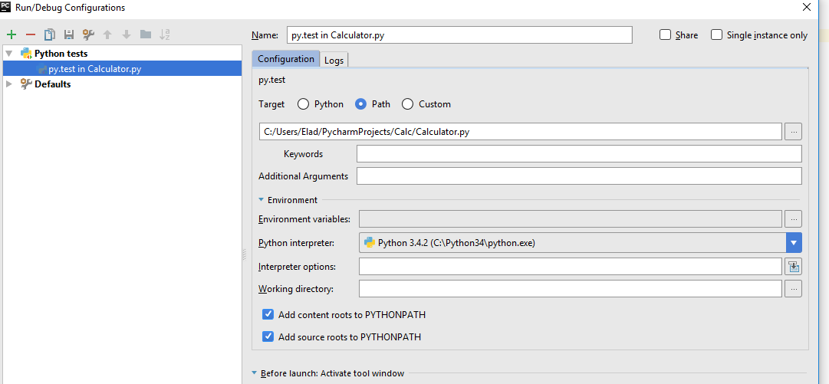

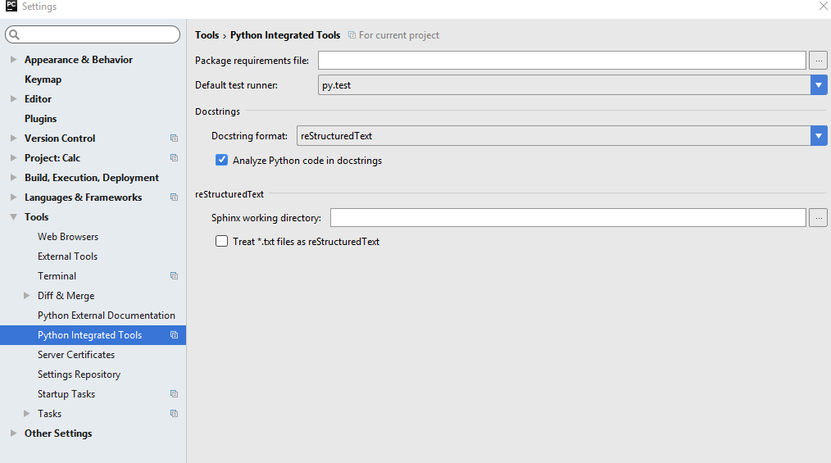
PyCharm Comfiguration
Run Configuration for project
File -> Settings

Slide 6
Python UUT Example
def Add(x, y): return x + y def Sub(x, y): return x - y

Slide 7
Python Test
import Calculator as calc def test_Add_Positive(): assert 8 == calc.Add(2, 6) def test_Add_Positive(): assert 9 == calc.Add(2, 6)

Slide 8
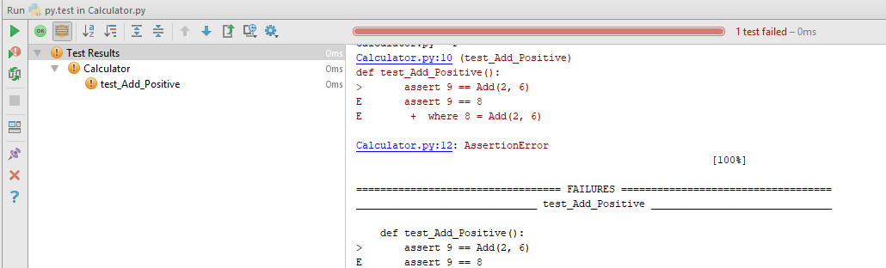
Run test from pycharm

Slide 9
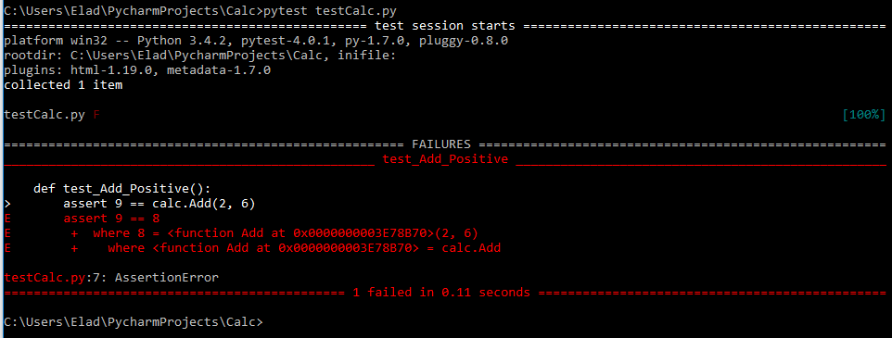
Run test from commandline

Slide 10
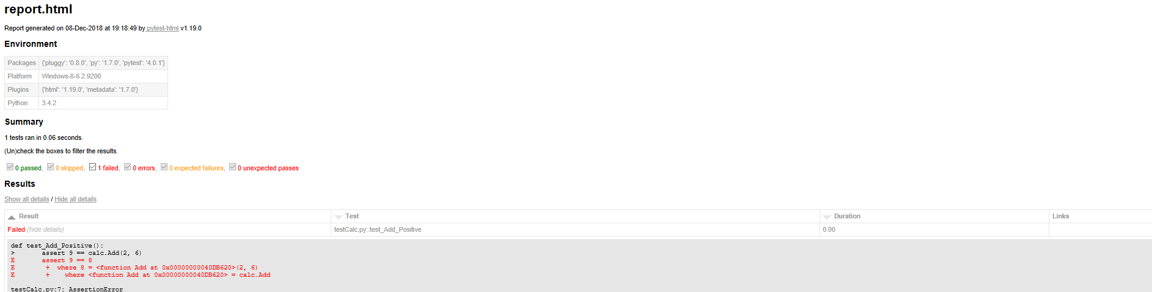
Get the results as html
pytest testCalc.py --html=report.html
An html report will be created in the working dir:
Working dir

Slide 11
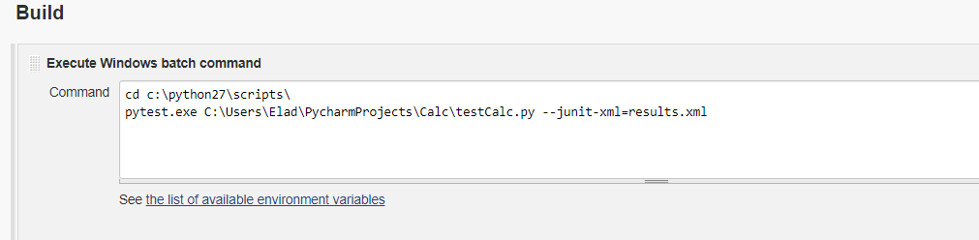
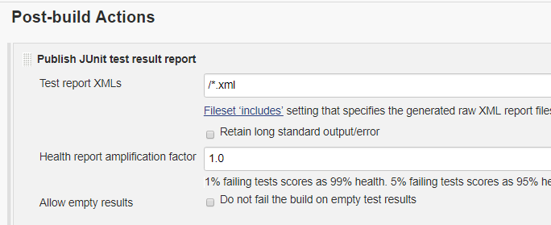
Pytest run from Jenkins

Slide 12
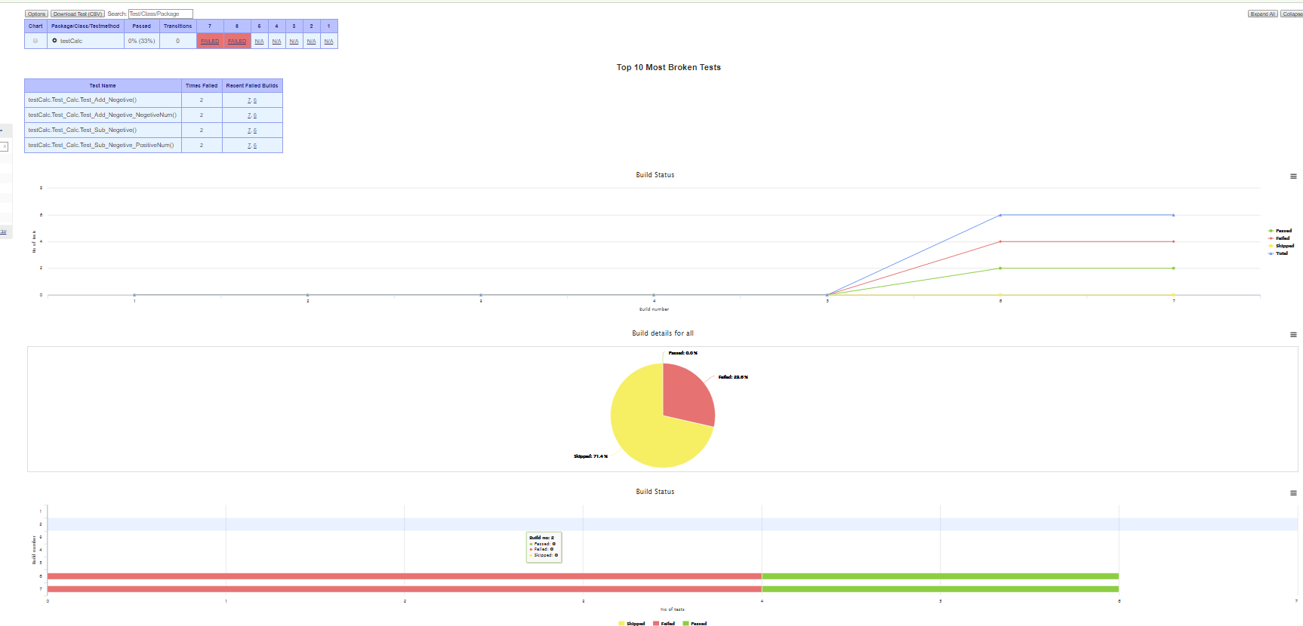
Test Result Analyzer

